Slide 1
INTEGRATED CIRCUITS

Slide 2
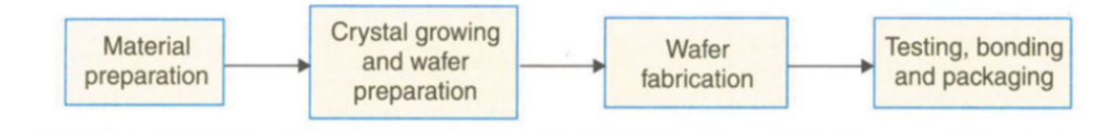
Manufacturing of ic

Slide 3
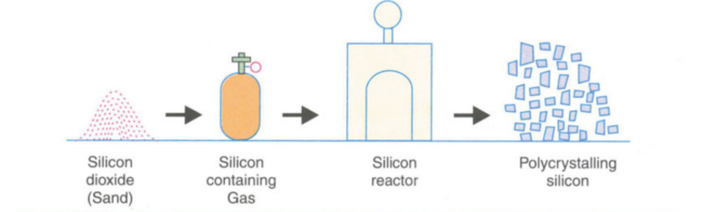
Material preparation

Slide 4
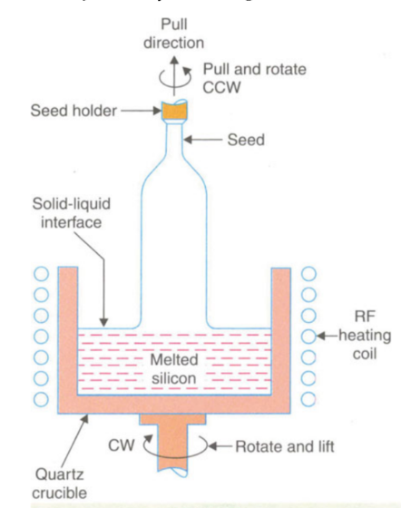
Crystal growing
This process is done to convert polycrystalline silicon to single crystalline silicon.
There are two methods to carry out crystal growth:
1.The czochralski process
2.The flat zone process

Slide 5
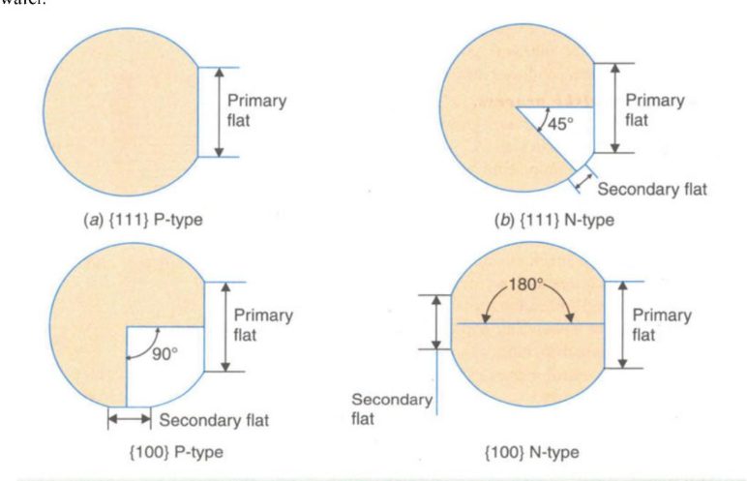
Wafer preparation
In this stage, the ingot surface is grounded throughout to an exact diameter and the top and bottom portions are cut off. The ingot is marked with two flat regions:
1.The larger flat(called primary flat)
2.The smaller flat(called secondary flat)

Slide 6
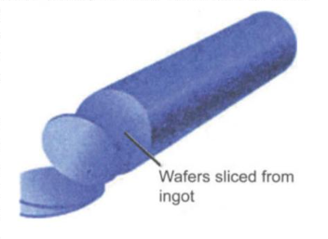
The semiconductor industry uses (111) wafers for fabricating ICs with bipolar transistor technology and (100) wafers for metal-oxide semiconductor (MOS) circuits.
Once the orientaions are done, the ingot is sliced into wafers by a high-speed diamond saw. The wafer thickness varies from 0.4 to 1.0 mm.
The lapped orientation usually leaves the surface edges contaminated and damaged.
These can be removed by a process called chemical etching.

Slide 7
WAFER FABRICATIONS
OXIDATION
ETCHING
DIFFUSION
ION IMPLANTATION
PHOTOLITHOGRAPHY
EPITAXY
METALLIZATION AND INTERCONNECTIONS
● The basic fabrication process is called planar process, ie., a process in which the introduction of impurities and metallic interconnections is carried out from the top of the wafer.
● A major advantage of the planer process is that each fabrication step is applied to all identical circuits and each of the many wafers at the same time.

Slide 8
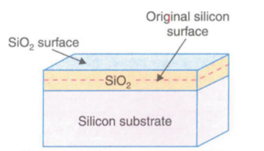
OXIDATION
The process of oxidation consists of growing a thin film of silicon dioxide (SiO,) on the surface of a silicon wafer. Silicon dioxide has several uses:
to serve as a mask against implant or diffusionof dopant into silicon,Silicon substrate
to provide surface passivation,
to isolate one device from another
to act as a component in MOS structures.

Slide 9
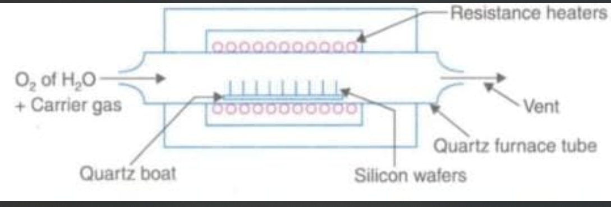
Several techniques developed for forming oxide layers.
Thermal oxidation
2. Vapour phase technique [chemical vapour deposition (CVD)]
3. Plasma oxidation

Slide 10
Etching
Wet etching
Done using chemical solution
Material to be etched is removed equally in all directions.
Dry etching
Done using plasma.
Also called reactive ion etching. In other words, the material to be etched is done only in the parts that is required

Slide 11
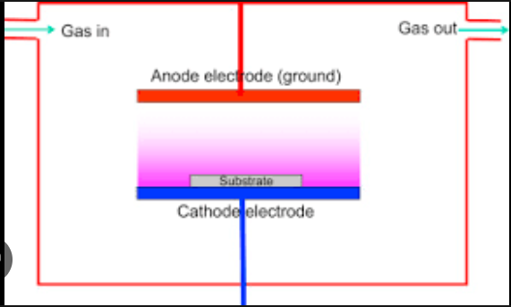
DRY etching
Wet etching is done with plasma
This plasma is created by passing electric field to aragon gas
The material to be etched is subjected to bombardment of its surface by gas ions

Slide 12
DIFFUSION occurs in two steps
Pre deposition diffusion
Drive-in diffusion

Slide 13
PRE DEPOSITION DIFUSSION
High concentration of dopant is introduced to silicon in 1000˚ C.
More recently a new method of pre-deposition is used known as ion implementation.
This method creates a heavily doped concentration of impurities in the silicon material.
Impurities that is doped are boron, phosphorous, arsenic and antimony.

Slide 14
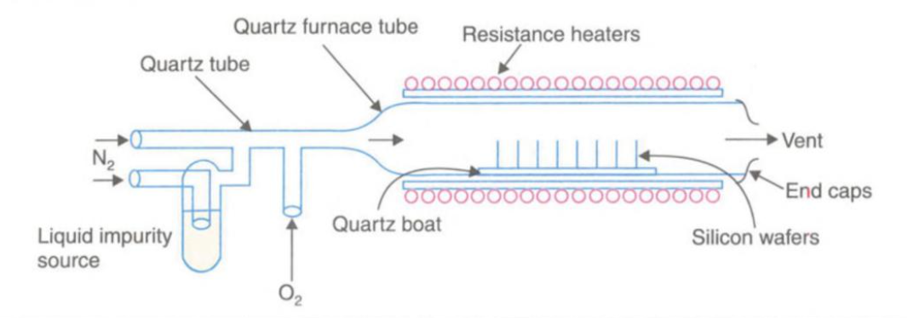
DIFFUSION
Impurity used: POCl3

Slide 15
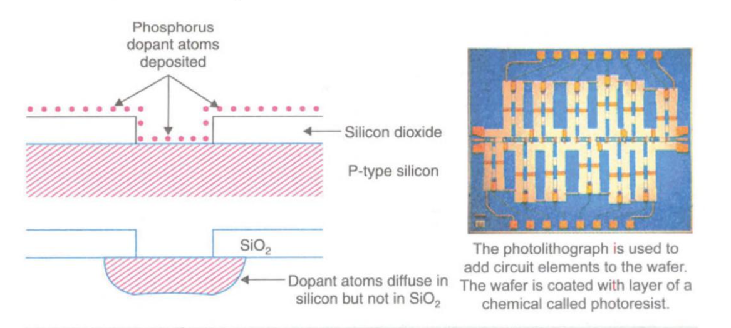
Drive in diffusion
This is driving the impurities deeper into the silicon surface.
Done is 1100˚C
Diffusion depth is controlled by temperature and time of the drive in diffusion process.

Slide 16
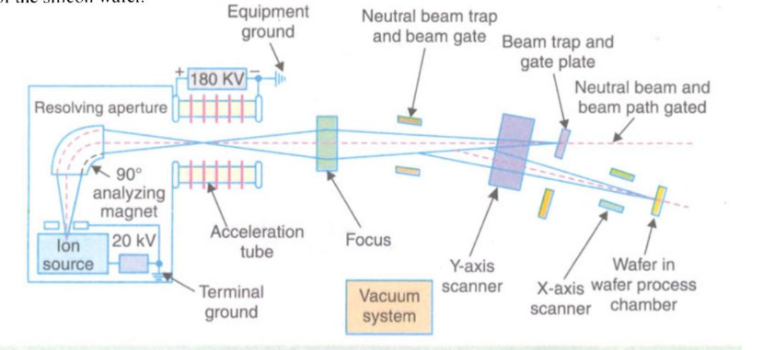
Ion implantation
Ion implantation :This is a process of introducing dopants into selected areas of the surface of the wafer by bombarding the surface with high-energy ions of the particular dopant.

Slide 17
PHOTOMASK GENERATION
To carry out one of the many fabrication process, a separate mask is required for each operation whose function is to expose the selected regions and protect the others.
There may be hundreds of identical dies (or ICs) on a wafer with each circuit containing hundreds of thousands or millions of devices.
Identical steps are carried out simultaneously for each process. For each process, separate mask is needed.

Slide 18
Ion implantation:
advantages
disadvantages
1. Doping levels can be precisely controlled since the incident ion beam can be accurately measured.
2. The depth of the dopant can be easily regulated by control of the incident ion velocity.
3. Extreme purity of the dopant is guaranteed.
Disadvantages:The ion implantation may create considerable damage to the crystal structure because of the collisons of the high-energy ions with the silicon.

